Slide 1
Coalition for Content Provenance and Authenticity (C2PA)

Slide 2
Agenda
C2PA Overview
Founding Members
Key Activities
Alignment with Project Origin and CAI
Membership Opportunities
Resources

Slide 3
Who we are

Slide 4
C2PA Charter
The C2PA is a Joint Development Foundation project whose mission is to develop technical specifications that can establish content provenance and authenticity at scale to give publishers, creators, and consumers the ability to trace the origin of media.
Charter | C2PA

Slide 5
February 2021

Slide 6
What we do

Slide 7

C2PA Key Activities
Applying requirements from industry to the development of content provenance specifications
Ensuring that the specifications can be used in ways that respect privacy and personal control of data, and promote tool availability for a wide range of organizations
Ensuring that specifications meet appropriate security requirements
Promoting selected specifications to become global standards
The global adoption of digital provenance techniques by target industry devices, systems, and services, including social media and messaging platforms
Ensuring that content accessibility is not negatively impacted by digital provenance techniques

Slide 8
Where we fit

Slide 9


Complementary Efforts
Developing a pipeline for signaling, certification and tracking the history of news content
Building a system to provide provenance and history for digital media

Slide 10
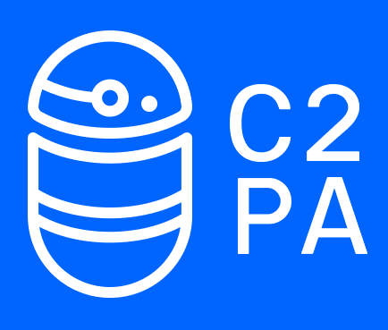
Working Together
Workflows and Requirements
Best Practices
Consuming Organizations
Specifications and Standards
Other Industry Initiatives
Reference Implementations

Slide 11
How to join

Slide 12
Apply Now!
Various Member Levels
Steering
(By invitation)
General
(By Application)
Contributor
(Open to all)
Apply at membership@c2pa.org

Slide 13
Membership Level Rights
 | Steering | General | Contributor
Manage the business, legal, and financial affairs of the Project
Approve the specifications for public publications
Approve new Working Groups
Chair the WG
Propose new work items in a WG
Vote to adopt new work items in a WG
Propose technical contributions to a Specification
Vote on technical contributions
Vote on procedural matters within a working group
Membership Cost Non-profit tier available Cost not inclusive of Linux Foundation membership | $27,000 | $5000 | $0

Slide 14
Resources

Slide 15
www.c2pa.org
Visit C2PA website for more information

